Slide 1
Time Series Analysis
- Jaiyesh Chahar

Slide 2
What is time series analysis
Time series analysis is a specific way of analyzing a sequence of data points collected over an interval of time.
What sets time series data apart from other data is that the analysis can show how variables change over time.

Slide 3
Some Simple Forecasting Methods
Average method: forecasts of all future values are equal to the average (or “mean”) of the historical data
Naïve method: yT+h|T=yT
Drift method: A variation on the naïve method is to allow the forecasts to increase or decrease over time, where the amount of change over time (called the drift) is set to be the average change seen in the historical data.

Slide 4
ARIMA Models
AR = Auto regression
MA = Moving Average
I = Integration

Slide 5
Why we need RNN or LSTMS?
Higher frequency time series often exhibit more complicated seasonal patterns. ARIMA is not able to deal with this
RNNs having a sense of memory which helps them in keeping track of what happened earlier in the sequential data, thus helping them gain context and identifying correlations and patterns.

Slide 6
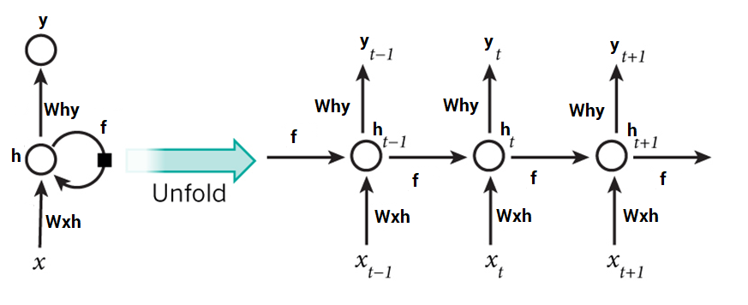
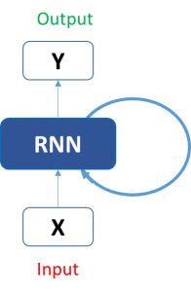
RNN
As gap grows, RNNs become unable to learn to connect the information

Slide 7
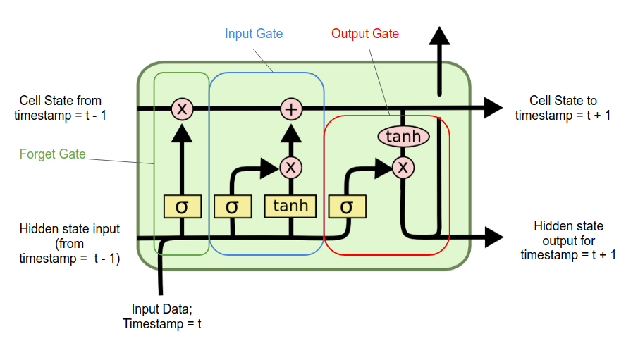
LSTMs
These are the parts that make up the LSTM cell:
The “Cell State”
The “Hidden State”
The Gates: “Forget” or also known as “Remember”, “Input”, and “Output”
Cell State:The cell state is meant to encode a kind of aggregation of data from all previous time-steps that have been processed.
Hidden state: meant to encode a kind of characterization of the previous time-step’s data

Slide 8
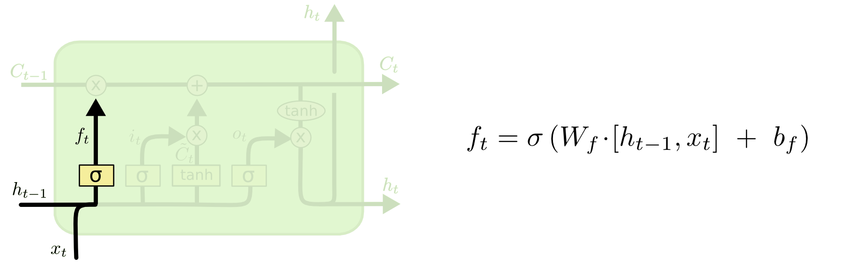
LSTM gates
The LSTM does have the ability to remove or add information to the cell state, carefully regulated by structures called gates.
Forget Gate: decide what information
we’re going to throw away
from the cell state.

Slide 9
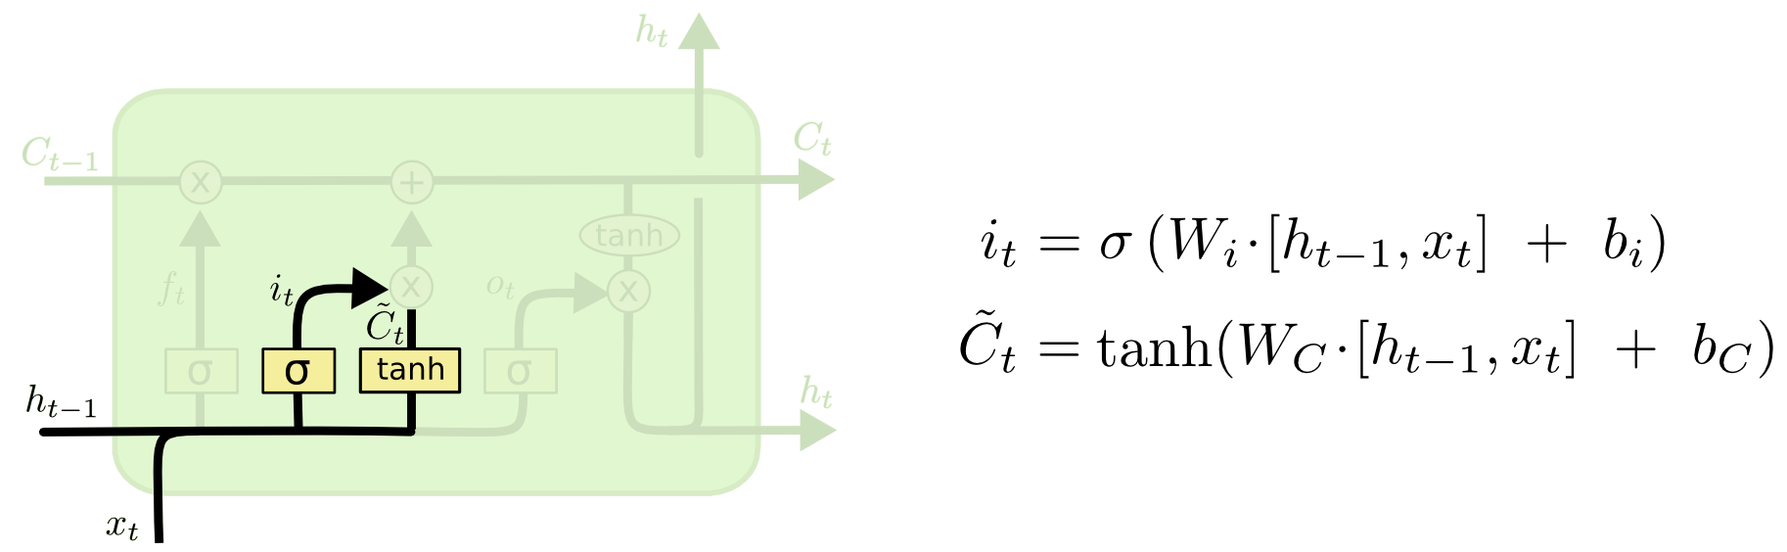
LSTM gates
2. Input Gate: decides which values we’ll update,Next, a tanh layer creates a vector of new candidate values, that could be added to the state. In the next step, we’ll combine these two to create an update to the state.

Slide 10
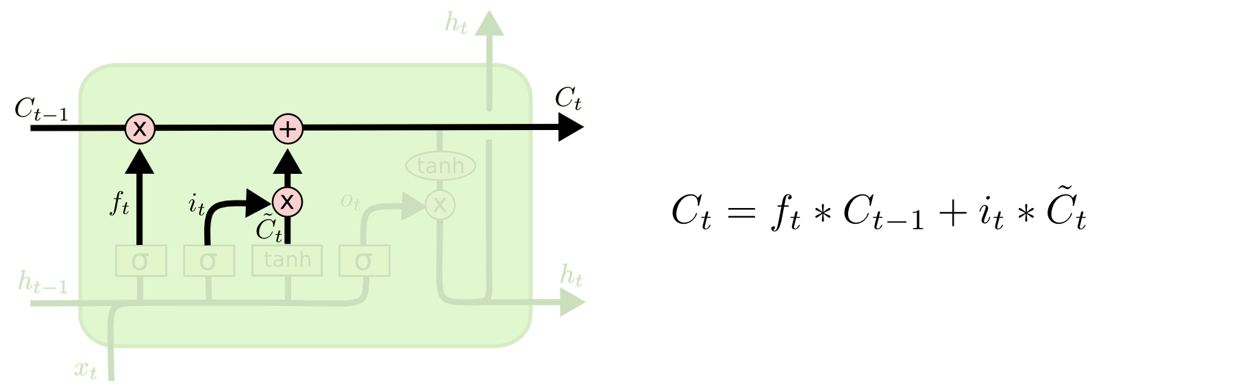
LSTM Gates
It’s now time to update the old cell state, into the new cell state.

Slide 11
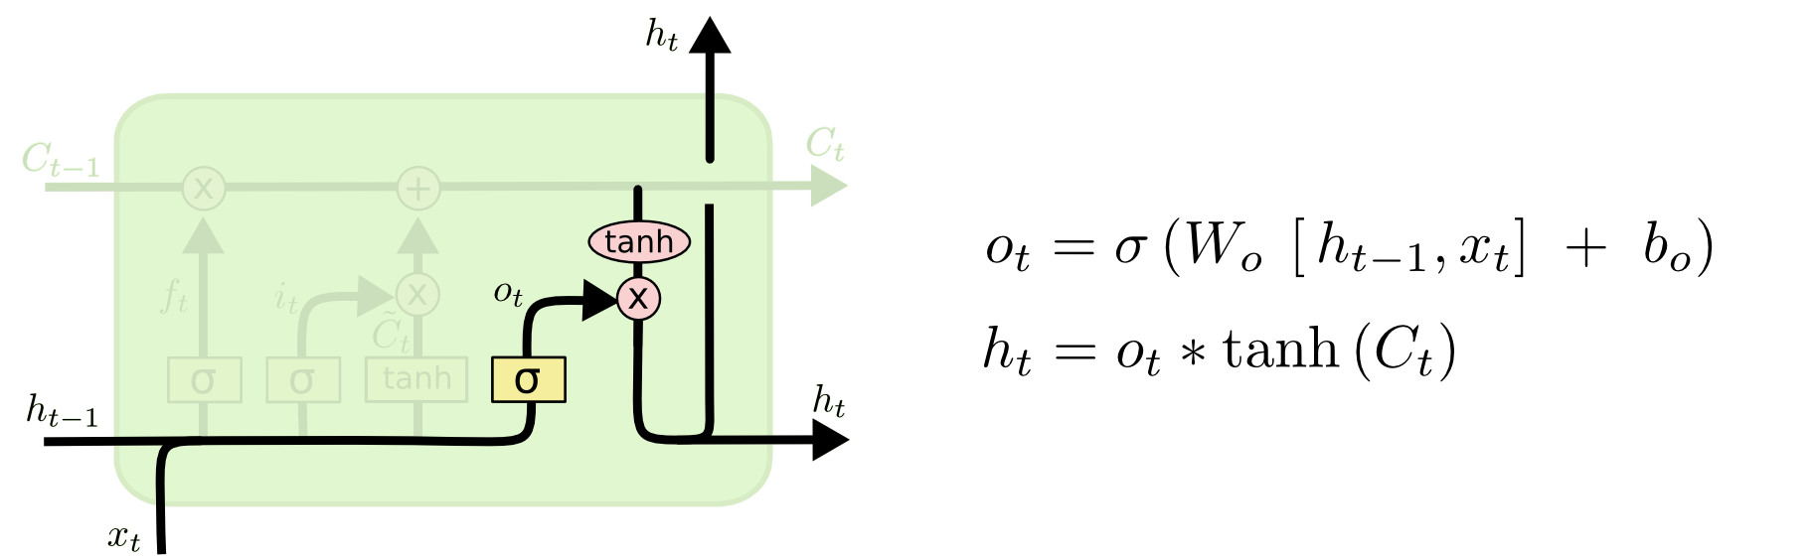
LSTM gates
Ouput Gate: Finally, we need to decide what we’re going to output. This output will be based on our cell state, but will be a filtered version. First, we run a sigmoid layer which decides what parts of the cell state we’re going to output. Then, we put the cell state through tanh (push values b/w -1 to 1) and multiply it by the output of the sigmoid gate, so that we only output the parts we decided to

